Slide 1
Time Series Analysis
Dr. Fadi Fawaz
Department of Economics and Finance
Tennessee State University©

Slide 2
Overview
What is time series?
Properties of time series data
Approaches to time series analysis
  ARIMA/Box-Jenkins, OLS, LSE, Sims, etc.
Stationarity and unit roots
Advanced topics
  Cointegration (ECM), time varying parameter models, VAR, ARCH

Slide 3
What is time series data?
A time series is a collection of data y_{t} (t=1,2,…,T), with the interval between y_{t} and y_{t+1} being fixed and constant.
We can think of time series as being generated by a stochastic process, or the data generating process (DGP).
A time series (sample) is a particular realization of the DGP (population).
Time series analysis is the estimation of difference equations containing stochastic (error) terms (Enders 2010).

Slide 4
Types of time series data
Single time series
  U.S. presidential approval, monthly (1978:1-2004:7)
  Number of militarized disputes in the world annually (1816-2001)
  Changes in the monthly Dow Jones stock market value (1978:1-2001:1)
Pooled time series
  Dyad-year analyses of interstate conflict
  State-year analyses of welfare policies
  Country-year analyses of economic growth

Slide 5
Properties of Time Series Data
Property #1: Time series data have autoregressive (AR), moving average (MA), and seasonal dynamic processes.
Because time series data are ordered in time, past values influence future values.
This often results in a violation of the assumption of no serial correlation in the residuals of a standard OLS model.
  Cov[ε_{i}, ε_{j}] = 0 if i ≠ j

Slide 6
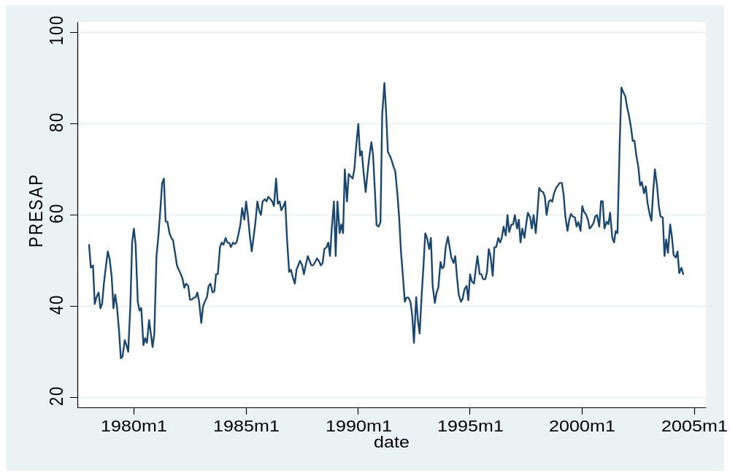
U.S. Monthly Presidential Approval Data, 1978:1-2004:7

Slide 7
OLS Strategies
When you first learned about serial correlation when taking an OLS class, you probably learned about techniques like generalized least squares (GLS) to correct the problem.
This is not ideal because we can improve our explanatory and forecasting abilities by modeling the dynamics in Y_{t}, X_{t}, and ε_{t}.
The naïve OLS approach can also produce spurious results when we do not account for temporal dynamics.

Slide 8
Properties of Time Series Data
Property #2: Time series data often have time-dependent moments (e.g. mean, variance, skewness, kurtosis).
The mean or variance of many time series increases over time.
This is a property of time series data called nonstationarity.
As Granger & Newbold (1974) demonstrated, if two independent, nonstationary series are regressed on each other, the chances for finding a spurious relationship are very high.

Slide 9
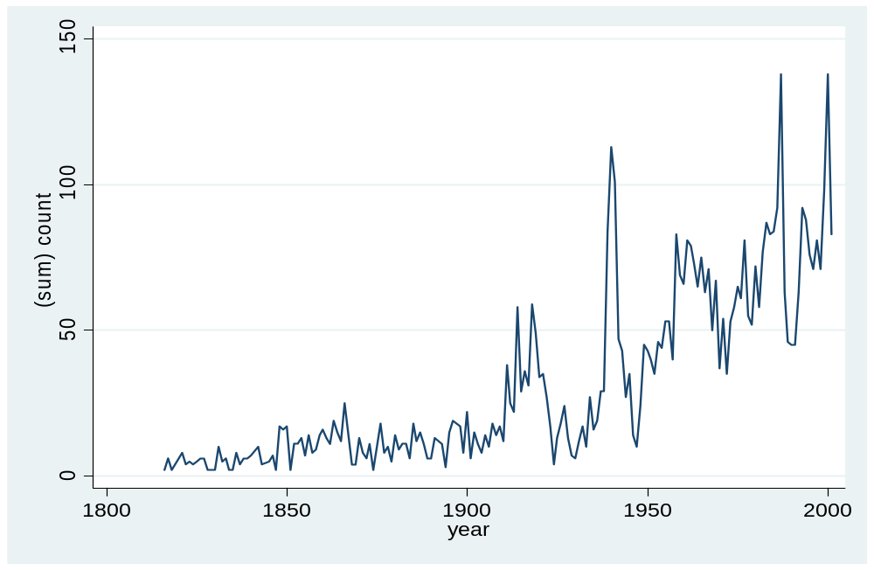
Number of Militarized Interstate Disputes (MIDs), 1816-2001

Slide 10
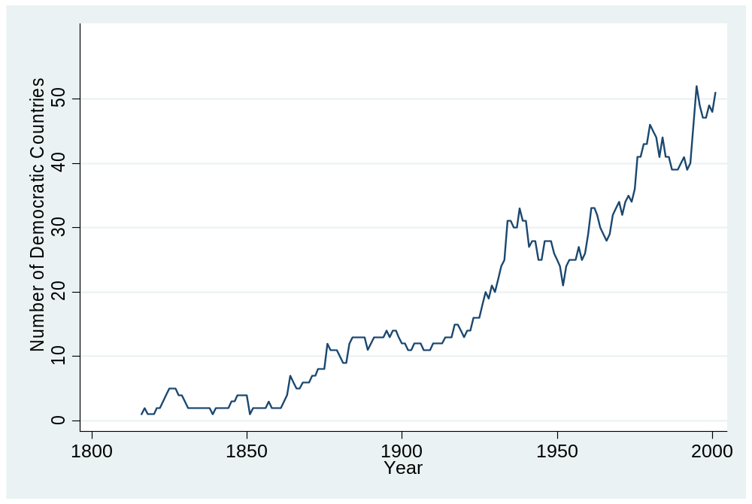
Number of Democracies, 1816-2001

Slide 11
Democracy-Conflict Example
We can see that the number of militarized disputes and the number of democracies is increasing over time.
If we do not account for the dynamic properties of each time series, we could erroneously conclude that more democracy causes more conflict.
These series also have significant changes or breaks over time (WWII, end of Cold War), which could alter the observed X-Y relationship.

Slide 12
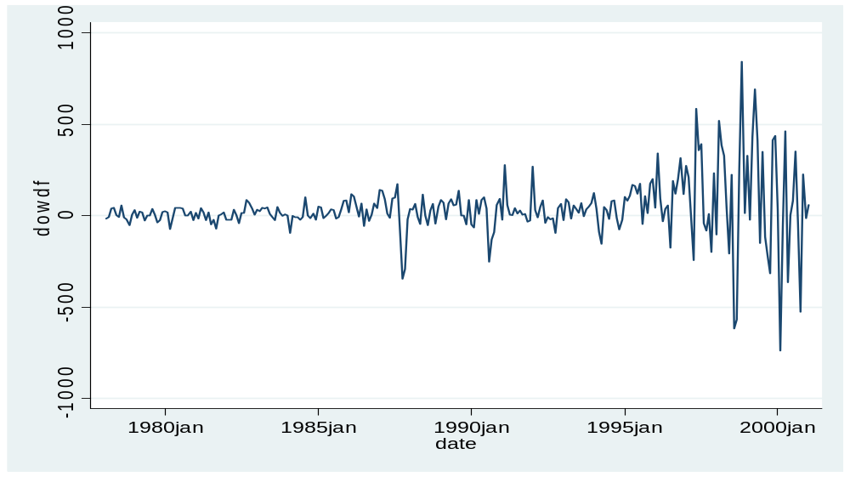
Nonstationarity in the Variance of a Series
If the variance of a series is not constant over time, we can model this heteroskedasticity using models like ARCH, GARCH, and EGARCH.
Example: Changes in the monthly DOW Jones value.

Slide 13
Properties of Time Series Data
Property #3: The sequential nature of time series data allows for forecasting of future events.
Property #4: Events in a time series can cause structural breaks in the data series. We can estimate these changes with intervention analysis, transfer function models, regime switching/Markov models, etc.

Slide 14
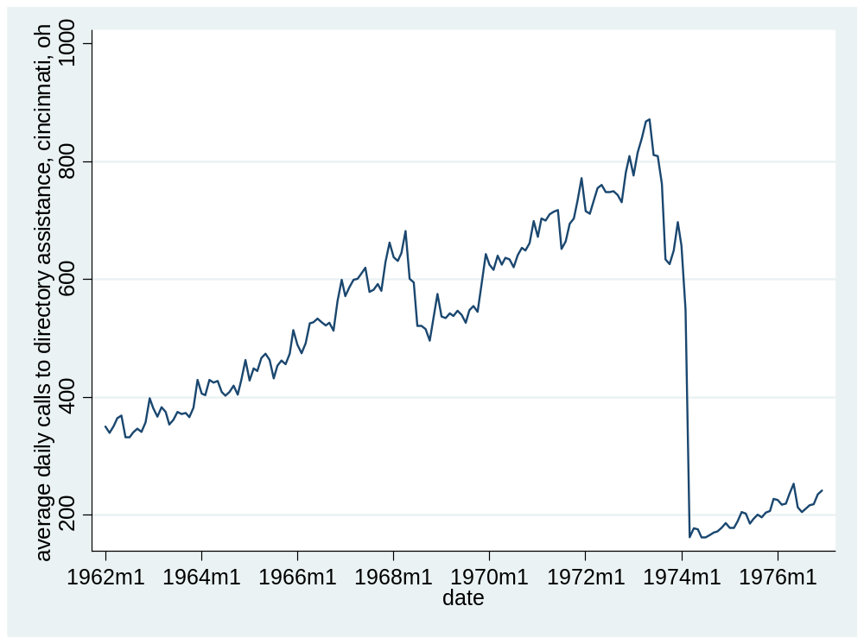

Slide 15
Properties of Time Series Data
Property #5: Many time series are in an equilibrium relationship over time, what we call cointegration. We can model this relationship with error correction models (ECM).
Property #6: Many time series data are endogenously related, which we can model with multi-equation time series approaches, such as vector autoregression (VAR).
Property #7: The effect of independent variables on a dependent variable can vary over time; we can estimate these dynamic effects with time varying parameter models.

Slide 16
Why not estimate time series with OLS?
OLS estimates are sensitive to outliers.
OLS attempts to minimize the sum of squares for errors; time series with a trend will result in OLS placing greater weight on the first and last observations.
OLS treats the regression relationship as deterministic, whereas time series have many stochastic trends.
We can do better modeling dynamics than treating them as a nuisance.

Slide 17
Regression Example, Approval
Regression Model: Dependent Variable is monthly US presidential approval, Independent Variables include unemployment (unempn), inflation (cpi), and the index of consumer sentiment (ics) from 1978:1 to 2004:7.
regress presap unempn cpi ics
Source | SS df MS Number of obs = 319
-------------+------------------------------ F( 3, 315) = 33.69
Model | 9712.96713 3 3237.65571 Prob > F = 0.0000
Residual | 30273.9534 315 96.1077885 R-squared = 0.2429
-------------+------------------------------ Adj R-squared = 0.2357
Total | 39986.9205 318 125.745033 Root MSE = 9.8035
------------------------------------------------------------------------------
presap | Coef. Std. Err. t P>|t| [95% Conf. Interval]
-------------+----------------------------------------------------------------
unempn | -.9439459 .496859 -1.90 0.058 -1.921528 .0336359
cpi | .0895431 .0206835 4.33 0.000 .0488478 .1302384
ics | .161511 .0559692 2.89 0.004 .0513902 .2716318
_cons | 34.71386 6.943318 5.00 0.000 21.05272 48.37501
------------------------------------------------------------------------------

Slide 18
Regression Example, Approval
Durbin's alternative test for autocorrelation
---------------------------------------------------------------------------
lags(p) | chi2 df Prob > chi2
-------------+-------------------------------------------------------------
1 | 1378.554 1 0.0000
---------------------------------------------------------------------------
H0: no serial correlation
The null hypothesis of no serial correlation is clearly violated. What if we included lagged approval to deal with serial correlation?

Slide 19
. regress presap lagpresap unempn cpi ics
Source | SS df MS Number of obs = 318
-------------+------------------------------ F( 4, 313) = 475.91
Model | 34339.005 4 8584.75125 Prob > F = 0.0000
Residual | 5646.11603 313 18.0387094 R-squared = 0.8588
-------------+------------------------------ Adj R-squared = 0.8570
Total | 39985.121 317 126.136028 Root MSE = 4.2472
------------------------------------------------------------------------------
presap | Coef. Std. Err. t P>|t| [95% Conf. Interval]
-------------+----------------------------------------------------------------
lagpresap | .8989938 .0243466 36.92 0.000 .8510901 .9468975
unempn | -.1577925 .2165935 -0.73 0.467 -.5839557 .2683708
cpi | .0026539 .0093552 0.28 0.777 -.0157531 .0210609
ics | .0361959 .0244928 1.48 0.140 -.0119955 .0843872
_cons | 2.970613 3.13184 0.95 0.344 -3.191507 9.132732
------------------------------------------------------------------------------
Durbin's alternative test for autocorrelation
---------------------------------------------------------------------------
lags(p) | chi2 df Prob > chi2
-------------+-------------------------------------------------------------
1 | 4.977 1 0.0257
---------------------------------------------------------------------------
H0: no serial correlation
We still have a problem with serial correlation and none of our independent variables has any effect on approval!

Slide 20
Approaches to Time Series Analysis
ARIMA/Box-Jenkins
  Focused on single series estimation
OLS
  Adapts OLS approach to take into account properties of time series (e.g. distributed lag models)
London School of Economics (Granger, Hendry, Richard, Engle, etc.)
  General to specific modeling
  Combination of theory & empirics
Minnesota (Sims)
  Treats all variables as endogenous
  Vector Autoregression (VAR)
  Bayesian approach (BVAR); see also Leamer (EBA)

Slide 21
Univariate Time Series Modeling Process
ARIMA (Autoregressive Integrated Moving Average)
Y_{t} → AR filter → Integration filter → MA filter
(long term) (stochastic trend) (short term)
→ ε_{t}
(white noise error)
y_{t} = a₁y_{t-1} + a₂y_{t-2} + ε_{t} + b₁ε_{t-1} ARIMA (2,0,1)
Δy_{t =} a₁ Δ y_{t-1} + ε_{t} ARIMA (1,1,0)
where Δy_{t} = y_{t} - y_{t-1}

Slide 22
Testing for Stationarity (Integration Filter)
mean: E(Y_{t}) = μ
variance: var(Y_{t}) = E( Y_{t} – μ)² = σ²
Covariance: γ_{k} = E[(Y_{t} – μ)(Y_{t-k} – μ)²
Forms of Stationarity: weak, strong (strict), super (Engle, Hendry, & Richard 1983)

Slide 23
Types of Stationarity
A time series is weakly stationary if its mean and variance are constant over time and the value of the covariance between two periods depends only on the distance (or lags) between the two periods.
A time series if strongly stationary if for any values j₁, j₂,…j_{n}, the joint distribution of (Y_{t}, Y_{t+j1}, Y_{t+j2},…Y_{t+jn}) depends only on the intervals separating the dates (j₁, j₂,…,j_{n}) and not on the date itself (t).
A weakly stationary series that is Gaussian (normal) is also strictly stationary.
This is why we often test for the normality of a time series.

Slide 24
Stationary vs. Nonstationary Series
Shocks (e.g. Watergate, 9/11) to a stationary series are temporary; the series reverts to its long run mean. For nonstationary series, shocks result in permanent moves away from the long run mean of the series.
Stationary series have a finite variance that is time invariant; for nonstationary series, σ² → ∞ as t → ∞.

Slide 25
Unit Roots
Consider an AR(1) model:
y_{t} = a₁y_{t-1} + ε_{t} (eq. 1)
ε_{t} ~ N(0, σ²)
Case #1: Random walk (a₁ = 1)
y_{t} = y_{t-1} + ε_{t}
Δy_{t} = ε_{t}

Slide 26
Unit Roots
In this model, the variance of the error term, ε_{t}, increases as t increases, in which case OLS will produce a downwardly biased estimate of a₁ (Hurwicz bias).
Rewrite equation 1 by subtracting y_{t-1} from both sides:
y_{t} – y_{t-1} = a₁y_{t-1} – y_{t-1} + ε_{t} (eq. 2)
Δy_{t} = δ y_{t-1} + ε_{t}
δ = (a₁ – 1)

Slide 27
Unit Roots
H₀: δ = 0 (there is a unit root)
H_{A}: δ ≠ 0 (there is not a unit root)
If δ = 0, then we can rewrite equation 2 as
Δy_{t} = ε_{t}
Thus first differences of a random walk time series are stationary, because by assumption, ε_{t} is purely random.
In general, a time series must be differenced d times to become stationary; it is integrated of order d or I(d). A stationary series is I(0). A random walk series is I(1).

Slide 28
Tests for Unit Roots
Dickey-Fuller test
  Estimates a regression using equation 2
  The usual t-statistic is not valid, thus D-F developed appropriate critical values.
  You can include a constant, trend, or both in the test.
  If you accept the null hypothesis, you conclude that the time series has a unit root.
  In that case, you should first difference the series before proceeding with analysis.

Slide 29
Tests for Unit Roots
Augmented Dickey-Fuller test (dfuller in STATA)
  We can use this version if we suspect there is autocorrelation in the residuals.
  This model is the same as the DF test, but includes lags of the residuals too.
Phillips-Perron test (pperron in STATA)
  Makes milder assumptions concerning the error term, allowing for the ε_{t} to be weakly dependent and heterogenously distributed.
Other tests include Variance Ratio test, Modified Rescaled Range test, & KPSS test.
There are also unit root tests for panel data (Levin et al 2002).

Slide 30
Tests for Unit Roots
These tests have been criticized for having low power (1-probability(Type II error)).
They tend to (falsely) accept H_{o} too often, finding unit roots frequently, especially with seasonally adjusted data or series with structural breaks. Results are also sensitive to # of lags used in the test.
Solution involves increasing the frequency of observations, or obtaining longer time series.

Slide 31
Trend Stationary vs. Difference Stationary
Traditionally in regression-based time series models, a time trend variable, t, was included as one of the regressors to avoid spurious correlation.
This practice is only valid if the trend variable is deterministic, not stochastic.
A trend stationary series has a DGP of:
y_{t} = a₀ + a₁t + ε_{t}

Slide 32
Trend Stationary vs. Difference Stationary
If the trend line itself is shifting, then it is stochastic.
A difference stationary time series has a DGP of:
y_{t} - y_{t-1} = a₀ + ε_{t}
Δy_{t} = a₀ + ε_{t}
Run the ADF test with a trend. If the test still shows a unit root (accept H_{o}), then conclude it is difference stationary. If you reject H_{o}, you could simply include the time trend in the model.

Slide 33
Example, presidential approval
. dfuller presap, lags(1) trend
Augmented Dickey-Fuller test for unit root Number of obs = 317
---------- Interpolated Dickey-Fuller ---------
Test 1% Critical 5% Critical 10% Critical
Statistic Value Value Value
------------------------------------------------------------------------------
Z(t) -4.183 -3.987 -3.427 -3.130
------------------------------------------------------------------------------
MacKinnon approximate p-value for Z(t) = 0.0047
. pperron presap
Phillips-Perron test for unit root Number of obs = 318
Newey-West lags = 5
---------- Interpolated Dickey-Fuller ---------
Test 1% Critical 5% Critical 10% Critical
Statistic Value Value Value
------------------------------------------------------------------------------
Z(rho) -26.181 -20.354 -14.000 -11.200
Z(t) -3.652 -3.455 -2.877 -2.570
------------------------------------------------------------------------------
MacKinnon approximate p-value for Z(t) = 0.0048

Slide 34
Example, presidential approval
With both tests (ADF, Phillips-Perron), we would reject the null hypothesis of a unit root and conclude that the approval series is stationary.
This makes sense because it is hard to imagine a bounded variable (0-100) having an infinitely exploding variance over time.
Yet, as scholars have shown, the series does have some persistence as it trends upward or downward, suggesting that a fractionally integrated model might work best (Box-Steffensmeier & De Boef).

Slide 35
Other types of integration
Case #2: Near Integration
  Even in cases where |a₁| < 1, but close to 1, we still have problems with spurious regression (DeBoef & Granato 1997).
  Solution: can log or first difference the time series; even though over differencing can induce non-stationarity, short term forecasts are often better
  DeBoef & Granato also suggest adding more lags of the dependent variable to the model.

Slide 36
Other types of integration
Case #3: Fractional Integration (Box-Steffensmeier & Smith 1998): (1-L)^{d}y_{t} = ε_{t}
stationary fractionally unit root
integrated
d=0 o < d < 1 d=1
low persistence high persistence
Useful for data like presidential approval or interstate conflict/cooperation that have long memoried processes, but are not unit roots (especially in the 0.5<d<1 range).

Slide 37
ARIMA (p,d,q) modeling
Identification: determine the appropriate values of p, d, & q using the ACF, PACF, and unit root tests (p is the AR order, d is the integration order, q is the MA order).
Estimation : estimate an ARIMA model using values of p, d, & q you think are appropriate.
Diagnostic checking: check residuals of estimated ARIMA model(s) to see if they are white noise; pick best model with well behaved residuals.
Forecasting: produce out of sample forecasts or set aside last few data points for in-sample forecasting.

Slide 38
Autocorrelation Function (ACF)
The ACF represents the degree of persistence over respective lags of a variable.
ρ_{k} = γ_{k} / γ₀ = covariance at lag k
variance
ρ_{k} = E[(y_{t} – μ)(y_{t-k} – μ)]²
E[(y_{t} – μ)²]
ACF (0) = 1, ACF (k) = ACF (-k)

Slide 39
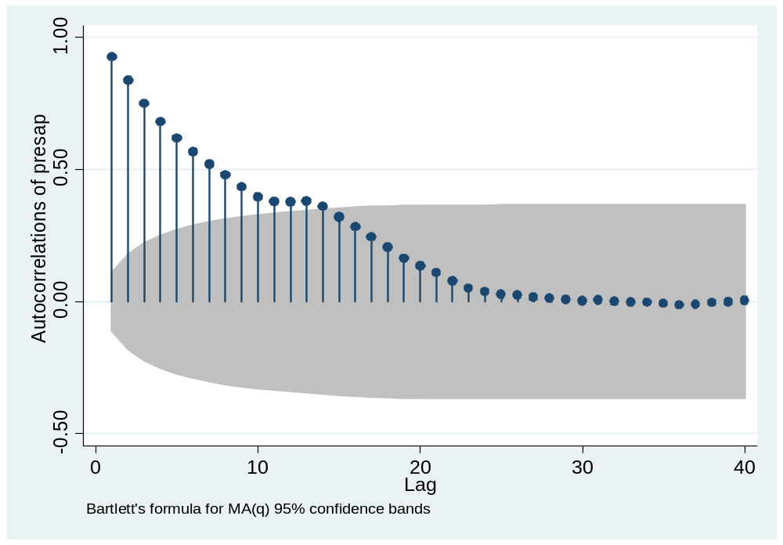
ACF example, presidential approval

Slide 40
ACF example, presidential approval
We can see the long persistence in the approval series.
Even though it does not contain a unit root, it does have long memory, whereby shocks to the series persist for at least 12 months.
If the ACF has a hyperbolic pattern, the series may be fractionally integrated.

Slide 41
Partial Autocorrelation Function (PACF)
The lag k partial autocorrelation is the partial regression coefficient, θ_{kk} in the k^{th} order autoregression:
y_{t} = θ_{k1}y_{t-1} + θ_{k2}y_{t-2} + …+ θ_{kk}y_{t-k} + ε_{t}

Slide 42
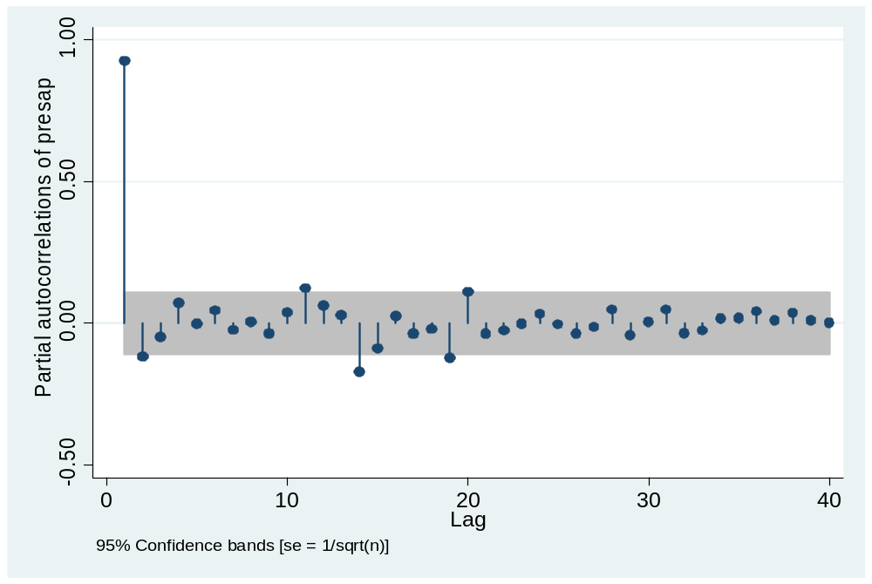
PACF example, presidential approval

Slide 43
PACF example, presidential approval
We see a strong partial coefficient at lag 1, and several other lags (2, 11, 14, 19, 20) producing significant values as well.
We can use information about the shape of the ACF and PACF to help identify the AR and MA orders for our ARIMA (p,d,q) model.
An AR(1) model can be rewritten as a MA(∞) model, while a MA(1) model can be rewritten as an AR(∞) model. We can use lower order representations of AR(p) models to represent higher order MA(q) models, and vice versa.

Slide 44
ACF/PACF Patterns
AR models tend to fit smooth time series well, while MA models tend to fit irregular series well. Some series combine elements of AR and MA processes.
Once we are working with a stationary time series, we can examine the ACF and PACF to help identify the proper number of lagged y (AR) terms and ε (MA) terms.

Slide 45
ACF/PACF
A full time series class would walk you through the mathematics behind these patterns. Here I will just show you the theoretical patterns for typical ARIMA models.
For the AR(1) model, │a₁ │< 1 (stationarity) ensures that the ACF dampens exponentially.
This is why it is important to test for unit roots before proceeding with ARIMA modeling.

Slide 46
AR Processes
For AR models, the ACF will dampen exponentially, either directly (0<a₁<1) or in an oscillating pattern (-1<a₁<0).
The PACF will identify the order of the AR model:
  The AR(1) model (y_{t} = a₁y_{t-1} + ε_{t}) would have one significant spike at lag 1 on the PACF.
  The AR(3) model (y_{t} = a₁y_{t-1}+a₂y_{t-2}+a₃y_{t-3}+ε_{t}) would have significant spikes on the PACF at lags 1, 2, & 3.

Slide 47
MA Processes
Recall that a MA(q) can be represented as an AR(∞), thus we expect the opposite patterns for MA processes.
The PACF will dampen exponentially.
The ACF will be used to identify the order of the MA process.
  MA(1) (y_{t} = ε_{t} + b₁ ε_{t-1}) has one significant spike in the ACF at lag 1.
  MA (3) (y_{t} = ε_{t} + b₁ ε_{t-1} + b₂ ε_{t-2} + b₃ ε_{t-3}) has three significant spikes in the ACF at lags 1, 2, & 3.

Slide 48
ARMA Processes
We may see dampening in both the ACF and PACF, which would indicate some combination of AR and MA processes.
We can try different models in the estimation stage.
  ARMA (1,1), ARMA (1, 2), ARMA (2,1), etc.
Once we have examined the ACF & PACF, we can move to the estimation stage.
Let’s look at the approval ACF/PACF again to help determine the ARMA order.

Slide 49
ACF example, presidential approval

Slide 50
PACF example, presidential approval

Slide 51
Approval Example
We have a dampening ACF and at least one significant spike in the PACF.
An AR(1) model would be a good candidate.
The significant spikes at lags 11, 14, 19, & 20, however, might cause problems in our estimation.
We could try AR(2) and AR(3) models, or alternatively an ARMA(1), since higher order AR can be represented as lower order MA processes.

Slide 52
Estimating & Comparing ARIMA Models
Estimate several models (STATA command, arima)
We can compare the models by looking at:
  Significance of AR, MA coefficients
  Compare the fit of the models using the AIC (Akaike Information Criterion) or BIC (Schwartz Bayesian Criterion); choose the model with the smallest AIC or BIC.
  Whether residuals of the models are white noise (diagnostic checking)

Slide 53
arima presap, arima(1,0,0)
ARIMA regression
Sample: 1978m1 - 2004m7 Number of obs = 319
Wald chi2(1) = 2133.49
Log likelihood = -915.1457 Prob > chi2 = 0.0000
------------------------------------------------------------------------------
| OPG
presap | Coef. Std. Err. z P>|z| [95% Conf. Interval]
-------------+----------------------------------------------------------------
presap |
_cons | 54.51659 3.411078 15.98 0.000 47.831 61.20218
-------------+----------------------------------------------------------------
ARMA |
ar |
L1. | .9230742 .0199844 46.19 0.000 .8839054 .9622429
-------------+----------------------------------------------------------------
/sigma | 4.249683 .0991476 42.86 0.000 4.055358 4.444009
------------------------------------------------------------------------------
estimates store m1
estat ic
-----------------------------------------------------------------------------
Model | Obs ll(null) ll(model) df AIC BIC
-------------+---------------------------------------------------------------
m1 | 319 . -915.1457 3 1836.291 1847.587
-----------------------------------------------------------------------------

Slide 54
The coefficient on the AR(1) is highly significant, although it is close to one, indicating a potential problem with nonstationarity. Even though the unit root tests show no problems, we can see why fractional integration techniques are often used for approval data.
Let’s check the residuals from the model (this is a chi-square test on the joint significance of all autocorrelations, or the ACF of the residuals).
wntestq resid_m1, lags(10)
Portmanteau test for white noise
---------------------------------------
Portmanteau (Q) statistic = 13.0857
Prob > chi2(10) = 0.2189
The null hypothesis of white noise residuals is accepted, thus we have a decent model. We could confirm this by examining the ACF & PACF of the residuals.

Slide 55
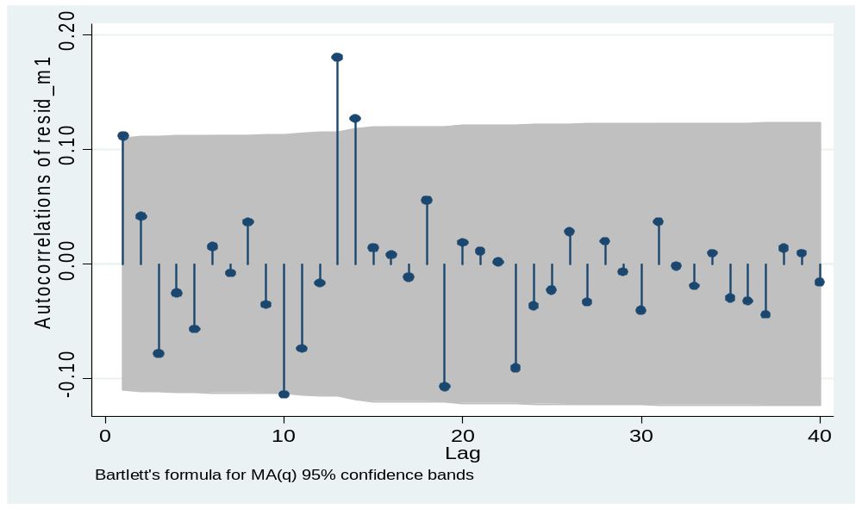
ACF of residuals, AR(1) model

Slide 56
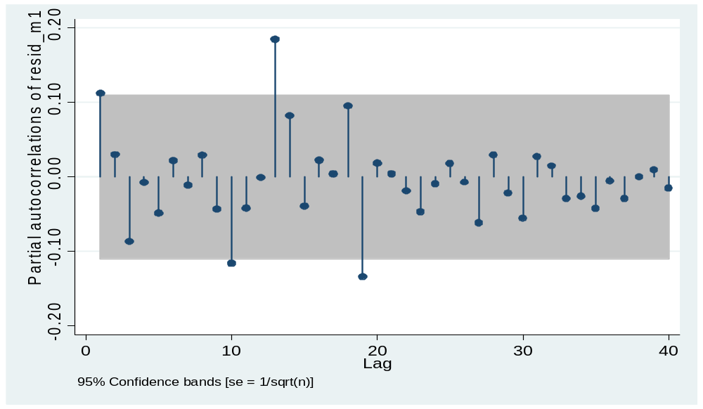
PACF of residuals, AR(1) model

Slide 57
ARMA(1,1) Model for Approval
arima presap, arima(1,0,1)
ARIMA regression
Sample: 1978m1 - 2004m7 Number of obs = 319
Wald chi2(2) = 1749.17
Log likelihood = -913.2023 Prob > chi2 = 0.0000
------------------------------------------------------------------------------
| OPG
presap | Coef. Std. Err. z P>|z| [95% Conf. Interval]
-------------+----------------------------------------------------------------
presap |
_cons | 54.58205 3.120286 17.49 0.000 48.4664 60.6977
-------------+----------------------------------------------------------------
ARMA |
ar |
L1. | .9073932 .0249738 36.33 0.000 .8584454 .956341
|
ma |
L1. | .1110644 .0438136 2.53 0.011 .0251913 .1969376
-------------+----------------------------------------------------------------
/sigma | 4.22375 .0980239 43.09 0.000 4.031627 4.415874
------------------------------------------------------------------------------
The AR & MA coefficients are both significant. Let’s compare this model to the AR(1) model.

Slide 58
Comparing Models
The ARMA(1,1) has a lower AIC than the AR(1), although the BIC is higher.
-----------------------------------------------------------------------------
Model | Obs ll(null) ll(model) df AIC BIC
-------------+---------------------------------------------------------------
m1 | 319 . -915.1457 3 1836.291 1847.587
-----------------------------------------------------------------------------
-----------------------------------------------------------------------------
Model | Obs ll(null) ll(model) df AIC BIC
-------------+---------------------------------------------------------------
m2 | 319 . -913.2023 4 1834.405 1849.465
-----------------------------------------------------------------------------

Slide 59
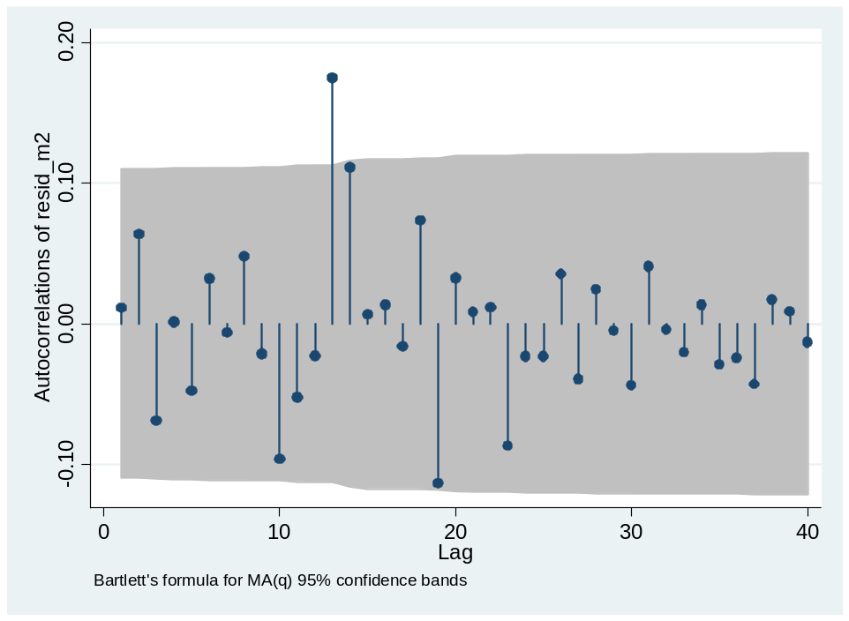
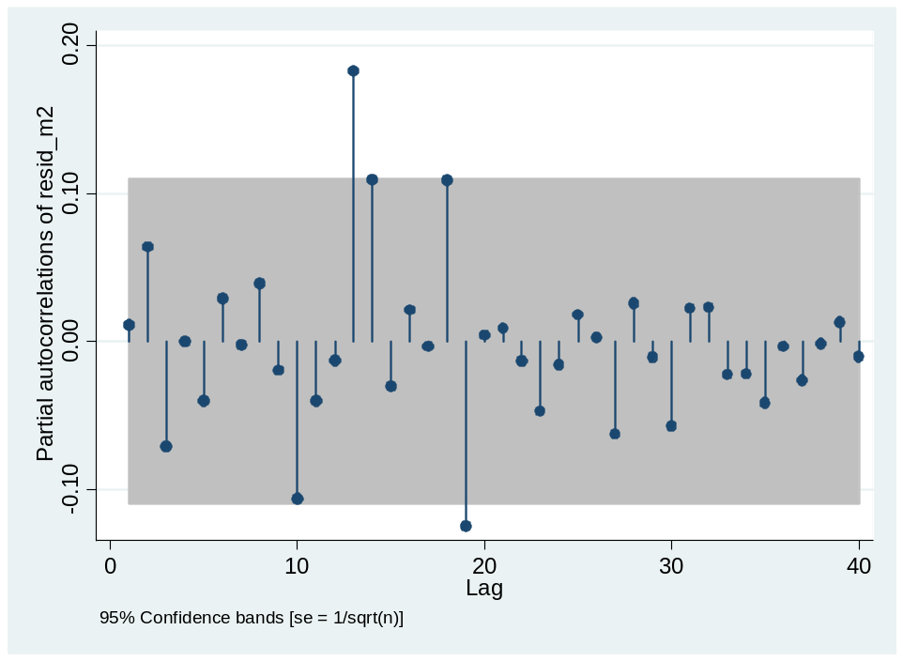
Checking Residuals of ARMA(1,1)
wntestq resid_m2, lags(10)
`Portmanteau test for white noise
---------------------------------------
Portmanteau (Q) statistic = 7.9763
Prob > chi2(10) = 0.6312

Slide 60
Forecasting
The last stage of the ARIMA modeling process would involve forecasting the last few points of the time series using the various models you had estimated.
You could compare them to see which one has the smallest forecasting error.

Slide 61
Similar approaches
Transfer function models involve pre-whitening the time series, removing all AR, MA, and integrated processes, and then estimating a standard OLS model.
Example: MacKuen, Erikson, & Stimson’s work on macro-partisanship (1989)
You can also estimate the level of fractional integration and then use the transformed data in OLS analysis (e.g. Box-Steffensmeier et al’s (2004) work on the partisan gender gap).
In OLS, we can add explanatory variables, and various lags of those as well (distributed lag models).

Slide 62
Interpreting Coefficients
If we include lagged variables for the dependent variable in an OLS model, we cannot simply interpret the β coefficients in the standard way.
Consider the model, Y_{t} = a₀ + a₁Y_{t-1} + b₁X_{t} + ε_{t}
The effect of X_{t} on Y_{t} occurs in period t, but also influences Y_{t} in period t+1 because we include a lagged value of Y_{t-1} in the model.
To capture these effects, we must calculate multipliers (impact, interim, total) or mean/median lags (how long it takes for the average effect to occur).

Slide 63
Total Multiplier
Consider the following ADL model (DeBoef & Keele 2008)
Y_{t} = α₀ + α₁Y_{t-1} + β₀X_{t} + β₁X_{t-1} +ε_{t}
The long run effect of X_{t} on Y_{t} is calculated as:
k₁ = (β₀ + β₁)/(1- α₁)
DeBoef & Keele show that many time series models place restrictions on this basic type of ADL model: partial adjustment, static, finite DL, differences, dead start, common factor. They can also be treated as restrictions on a general error correction model (ECM).

Slide 64
Advanced Topics: Cointegration
As noted earlier, sometimes two or more time series move together in an equilibrium relationship.
For example, some scholars have argued that presidential approval is in equilibrium with economic conditions (Ostrom and Smith 1992).
If the economy is doing well and approval is too low, it will increase; if the economy is doing poorly, and the president has high approval, it will fall back to the equilibrium level.

Slide 65
Advanced Topics: Cointegration
  Granger (1983) showed that if two variables are cointegrated, then they have an error correction representation (ECM):
  In Ostrom and Smith’s (1992) model:
  ΔA_{t} = ΔX_{t}β + γ(A_{t-1} - X_{t-1}ν) + ε_{t}
  where A_{t} = approval
  X_{t} = quality of life outcome

Slide 66
Advanced Topics: Cointegration
Two time series are cointegrated if:
  They are integrated of the same order, I(d)
  There exists a linear combination of the two variables that is stationary (I(0)).
  Most of the cointegration literature focuses on the case in which each variable has a single unit root (I(1)).
Tests by Engle-Granger involve 1) unit root tests, 2) estimating an OLS model on the I(1) variables, 3) saving residuals, and 4) testing whether the first order autocorrelation coefficient has a unit root (they are not cointegrated) or not (they are cointegrated), Δe_{t} = a₁e_{t-1 +} ε_{t}.

Slide 67
Advanced Topics: Cointegration
Then an ECM is estimated using the lagged residuals from previous step (e_{t-1}) as instruments for the long run equilibrium term.
We can use ECM representations, though, even if all variables are I(0) (DeBoef and Keele 2008).

Slide 68
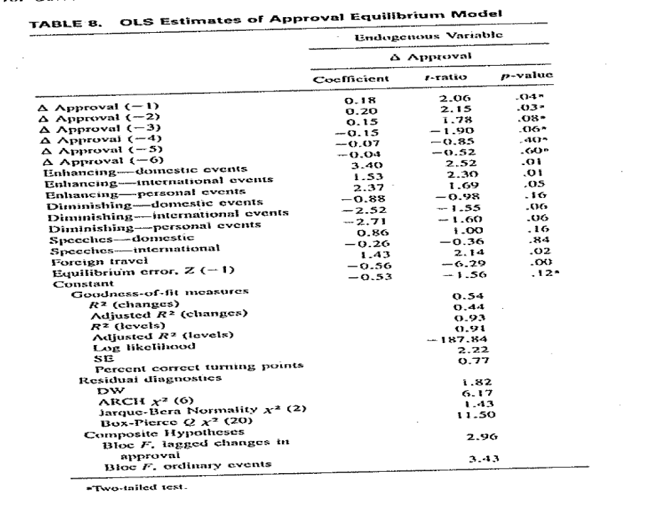

Slide 69
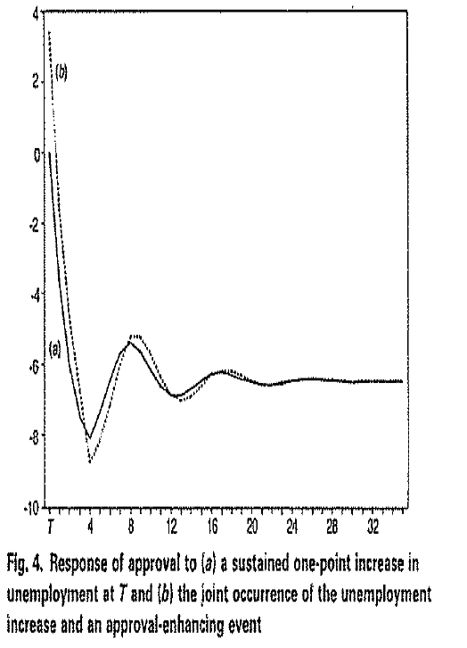

Slide 70
Advanced Topics: Time Varying Parameter (TVP) Models
Theory might suggest that the effect of X_{t} on Y_{t} is not constant over time.
In my research, for example, I hypothesize that the effect of democracy on war is getting stronger and more negative (pacific) over time.
If this is true, estimating a single parameter across a 200 year time period is problematic.

Slide 71
Advanced topics: TVP Models
We can check for structural breaks in our data set using Chow (or other) tests.
We can estimate time varying parameters with a variety of models, including:
  Switching regression/threshold models
  Rolling regression models
  Kalman filter models (Beck 1983, 1989)
  Random coefficients model

Slide 72
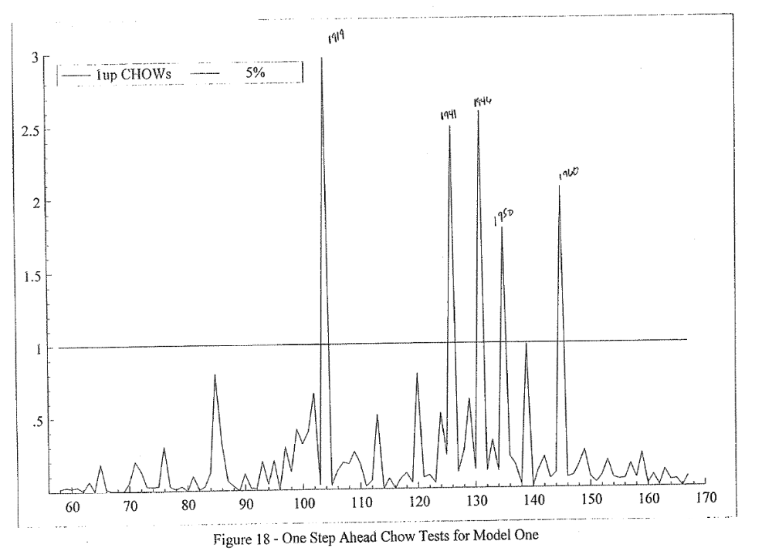

Slide 73
TVP, Approval Example
Let’s take our approval model and estimate rolling regression in STATA (rolling).
I selected 30 month windows; we could make these larger or smaller.
We can plot the time varying effects over time, as well as standard errors around those estimates.

Slide 74
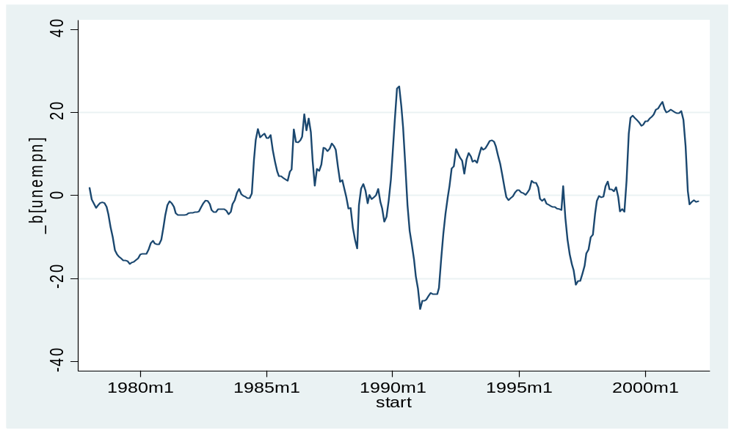
Effect of Unemployment on Approval

Slide 75
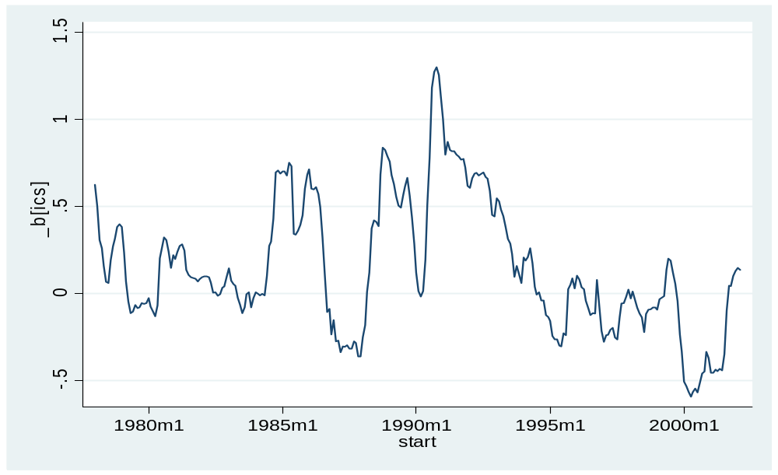
Effect of ICS on Approval

Slide 76
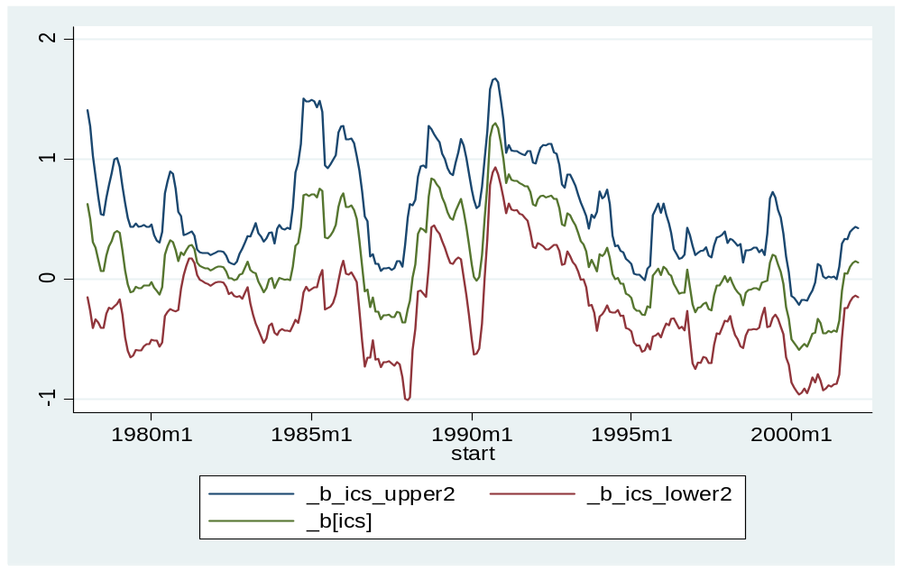
Effect of ICS on Approval, with SE

Slide 77
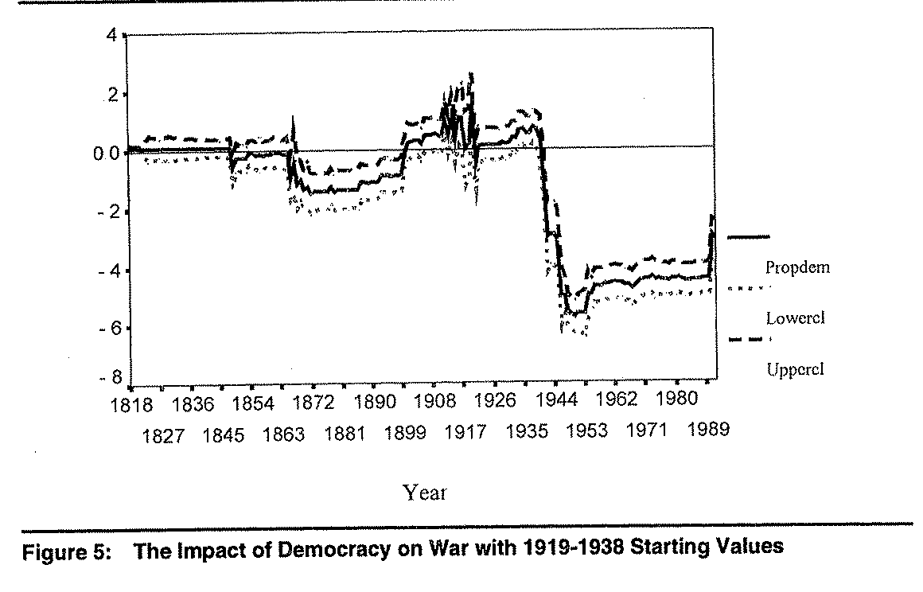

Slide 78
Advanced Topics: VAR
VAR is a useful model that allows all variables to be endogenous. If you have 3 variables, you have 3 equations, with each variable containing a certain number of lags in each equation.
You estimate the system of equations and you can then examine how variables respond when another variable is shocked above its mean.
See Brandt & Williams, Sage Monograph (2007)

Slide 79
Advanced Topics: ARCH
ARCH models are useful if you have non-constant variance, especially if that high variance occurs in only certain periods in the dataset (conditional heteroskedasticity)
Recall the change in the DOW Jones series, which had increasing variance over time.
The ARCH approach adds squared values of the estimated residuals (created from the best fitting ARMA model if they are significantly different from zero in the ACF; akin to the residual test we used earlier).
GARCH allows for AR and MA processes in the residuals; TGARCH allows for threshold/regime changes; EGARCH allows for negative coefficients in the ARMA process.

